Slide 1
Weighted least squares
蒋智超
2025年 秋

Slide 2



Generalized least squares
Generalized Gauss-Markov model
Two leading cases

Slide 3

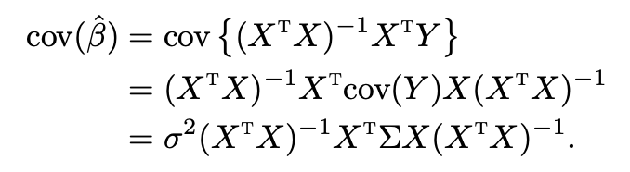
OLS estimator
We can still use the OLS estimator
It is not BLUE under the Generalized Gauss-Markov model

Slide 4

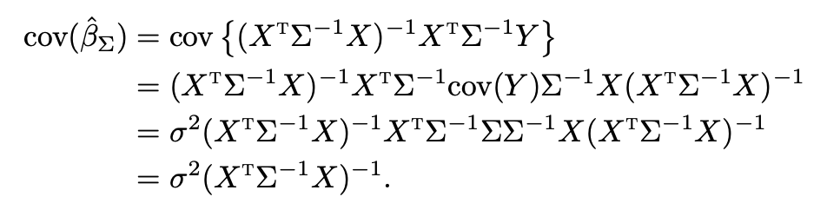
BLUE
We can transform the Generalized Gauss-Markov model into the Gauss-Markov model
The BLUE is

Slide 5

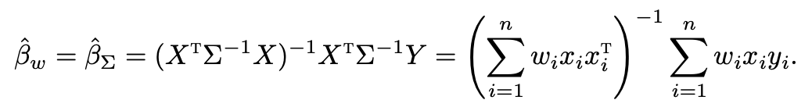
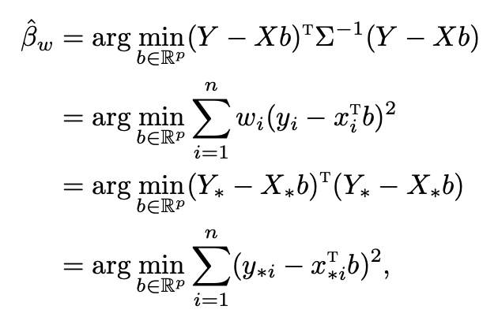

Weighted least squares
We focus on the covariance structure
Weighted least squares (WLS) estimator

Slide 6


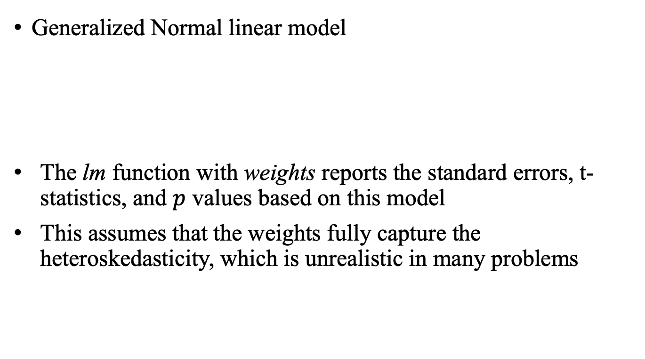
Weighted least squares
Generalized Normal linear model
The lm function with weights reports the standard errors, t-statistics, and $p$ values based on this model
This assumes that the weights fully capture the heteroskedasticity, which is unrealistic in many problems

Slide 7

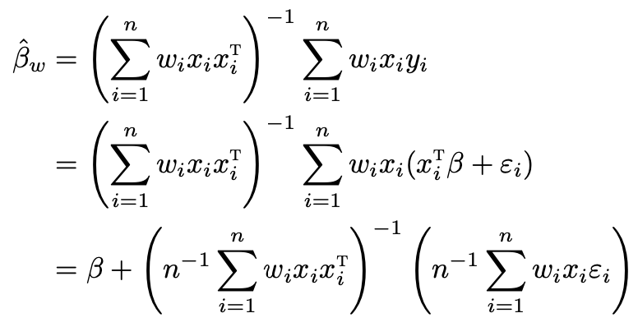
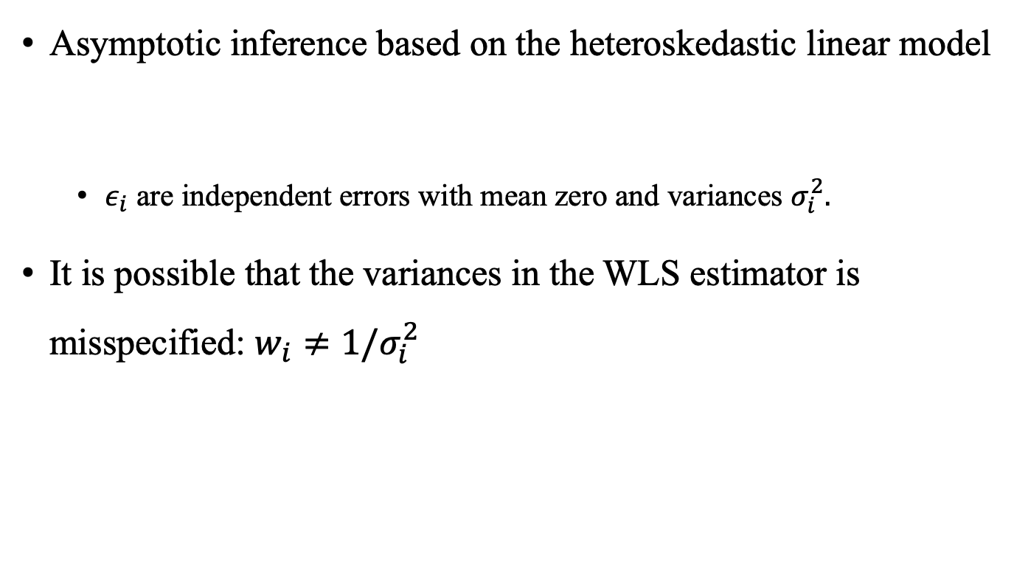
Weighted least squares
Asymptotic inference based on the heteroskedastic linear model
$ε_{i}$ are independent errors with mean zero and variances $σ_{i}^{2}.$
It is possible that the variances in the WLS estimator is misspecified: $w_{i}≠1/σ_{i}^{2}$

Slide 8

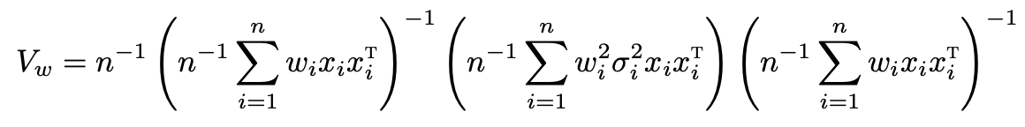
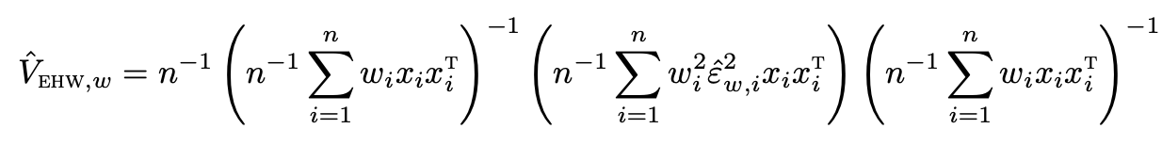

Weighted least squares
There is no guarantee that ${\hat{β}}_{w}$ is BLUE, but it is still unbiased
We can apply LLN to show ${\hat{β}}_{w}$ is consistent for $β$
We can apply CLT to show

Slide 9
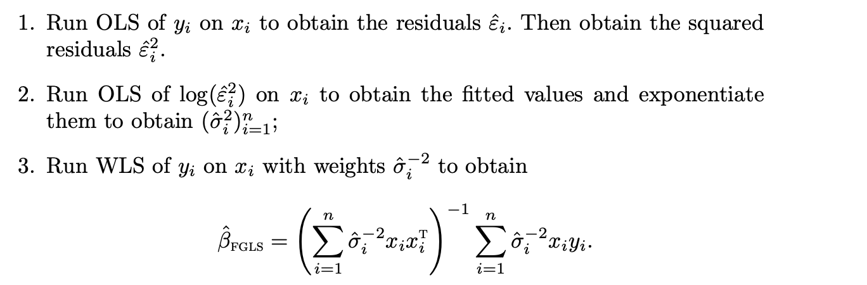

Feasible generalized least squares
Assume $ε$ has mean zero and covariance diag{$σ_{1}^{2},…,σ_{n}^{2}$}
If we know $σ_{i}^{2}$, then we can apply WLS
If we do not know $σ_{i}^{2}$, then we need to estimate them first
Feasible generalized least squares (GLS)
Notes:
In step 2 we can change the model based on our understanding of heteroskedasticity

Slide 10
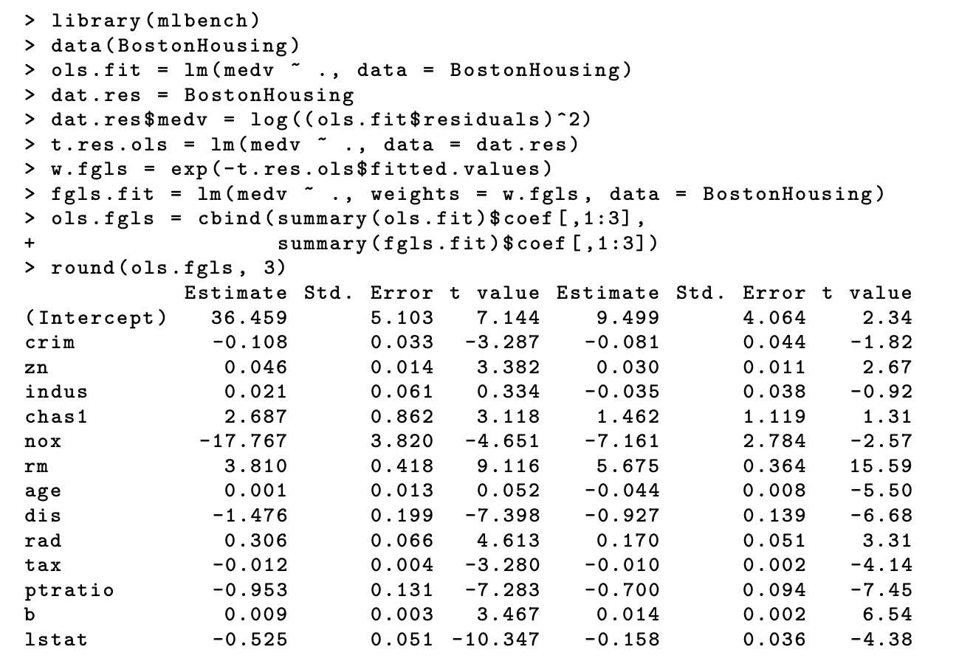
Feasible generalized least squares
Notes:
This suggests that the linear model may be misspecified.

Slide 11
Remark
We can change the model on the variances in step 2 based on our understanding of heteroskedasticity
It is unusual for practitioners to use FGLS
EHW standard errors are convenient under heteroskedasticity
Efficiency gain is usually small
Linear model is likely to be misspecified. If so, OLS and FGLS estimate different parameters. The OLS has the interpretation of best linear approximations.

Slide 12
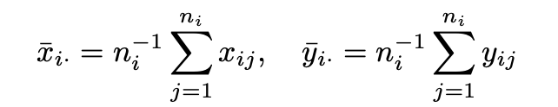
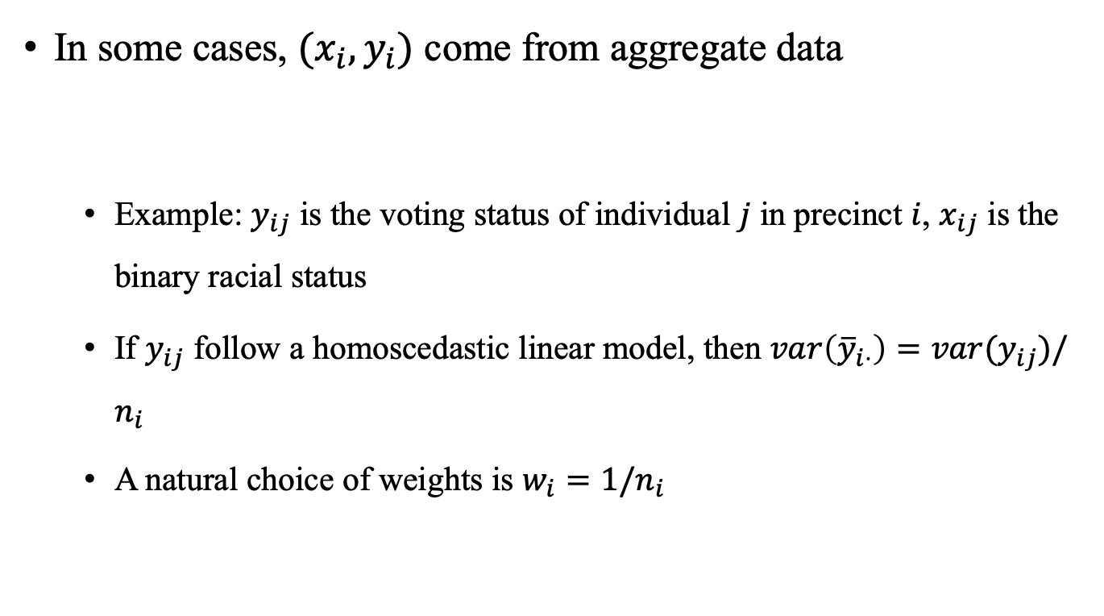
Aggregate data
In some cases, $(x_{i},y_{i})$ come from aggregate data
Example: $y_{ij}$ is the voting status of individual $j$ in precinct $i$, $x_{ij}$ is the binary racial status
If $y_{ij}$ follow a homoscedastic linear model, then $var\left({\overline{y}}_{i⋅}\right)=var(y_{ij})/n_{i}$
A natural choice of weights is $w_{i}=1/n_{i}$

Slide 13
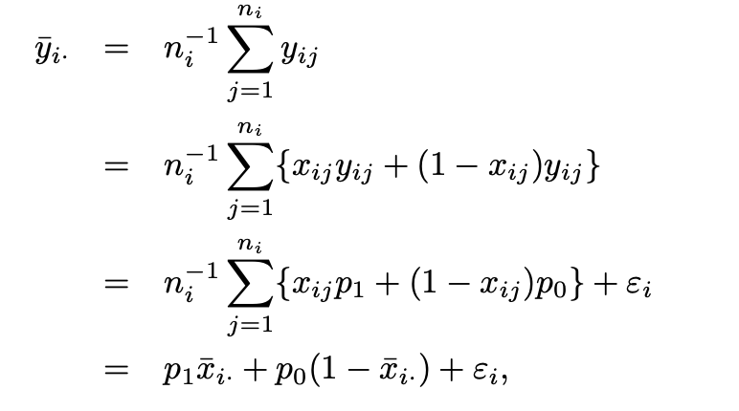
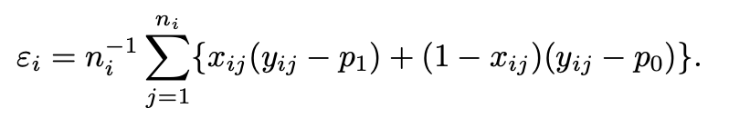

Can we infer individual behavior from aggregate data?
Suppose that the precinct $i$ has individual data $\{x_{ij},y_{ij}:j=1,…,n_{j}\}$
We only observe
Goodman’s ecological regression
Individual level model
Assume $p_{i1}$ and $p_{i0}$ are random and independent of the $x_{ij}$’s, with $E\left(p_{i1}\right)=p_{1}$ and $E\left(p_{i0}\right)=p_{0}$

Slide 14


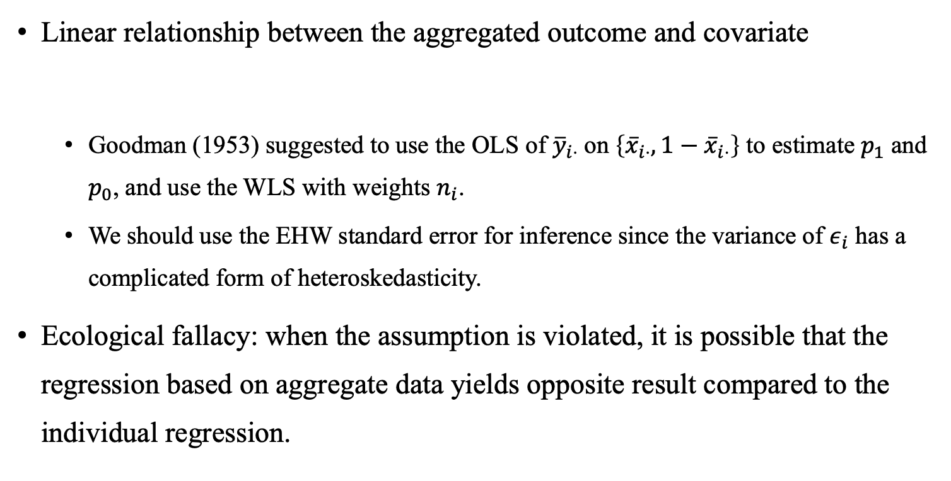
Ecological regression
Linear relationship between the aggregated outcome and covariate
Goodman (1953) suggested to use the OLS of ${\overline{y}}_{i⋅}$on $\left\{{\overline{x}}_{i⋅},1−{\overline{x}}_{i⋅}\right\}$ to estimate $p_{1}$ and $p_{0}$, and use the WLS with weights $n_{i}$.
We should use the EHW standard error for inference since the variance of $ε_{i}$ has a complicated form of heteroskedasticity.
Ecological fallacy: when the assumption is violated, it is possible that the regression based on aggregate data yields opposite result compared to the individual regression.

Slide 15
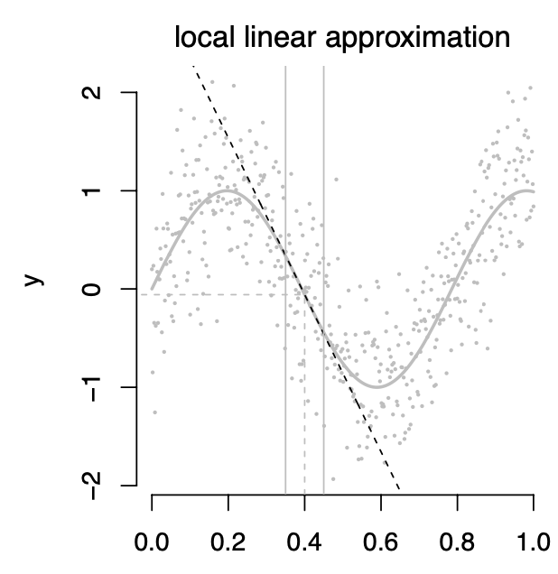

Local linear regression
We can approximate any smooth function at a point $x_{0}$ by a linear function $f\left(x\right)=f\left(x_{0}\right)+f′(x_{0})(x−x_{0})$

Slide 16
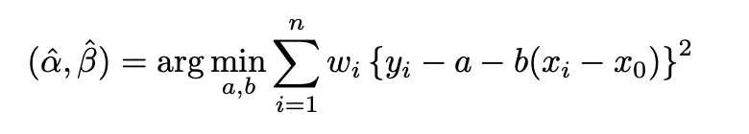
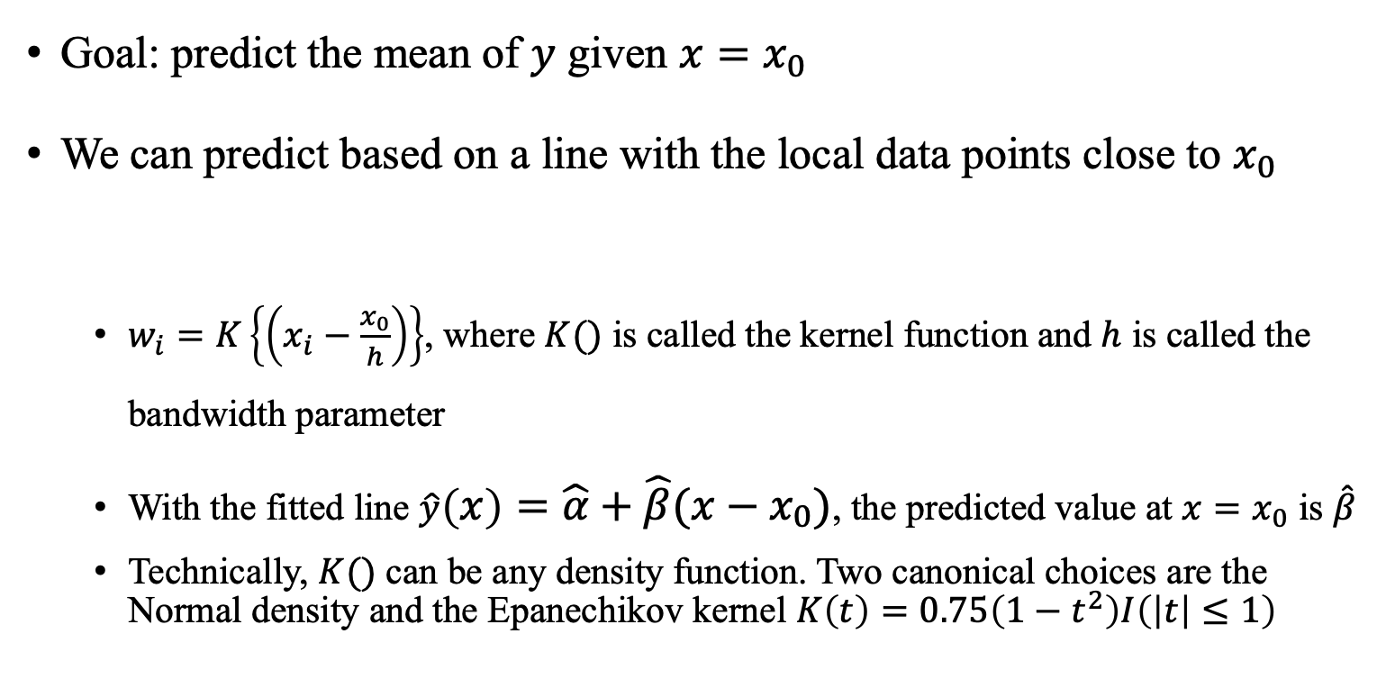
Local linear regression
Goal: predict the mean of $y$ given ${x=x}_{0}$
We can predict based on a line with the local data points close to $x_{0}$
$w_{i}=K\left\{\left(x_{i}−\frac{x_{0}}{h}\right)\right\}$, where $K()$ is called the kernel function and $h$ is called the bandwidth parameter
With the fitted line $\hat{y}\left(x\right)=\hat{α}+\hat{β}(x−x_{0})$, the predicted value at ${x=x}_{0}$ is $\hat{β}$
Technically, $K()$ can be any density function. Two canonical choices are the Normal density and the Epanechikov kernel $K\left(t\right)=0.75\left(1−t^{2}\right)I\left(\left|t\right|≤1\right)$

Slide 17
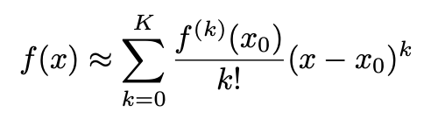
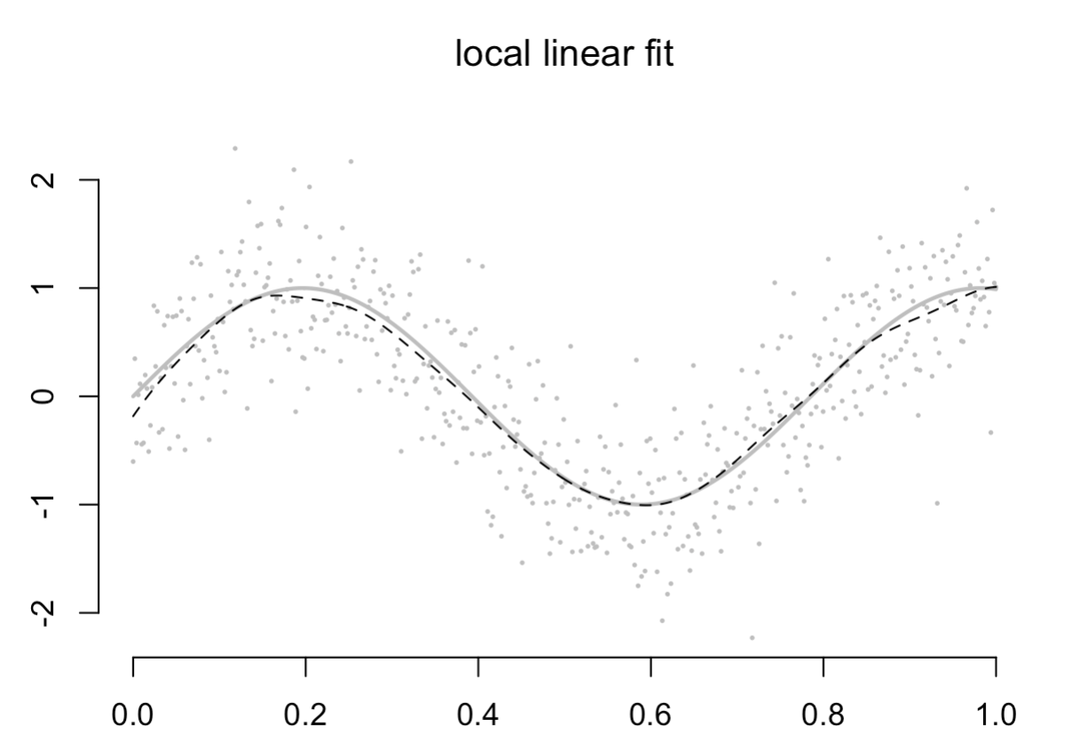
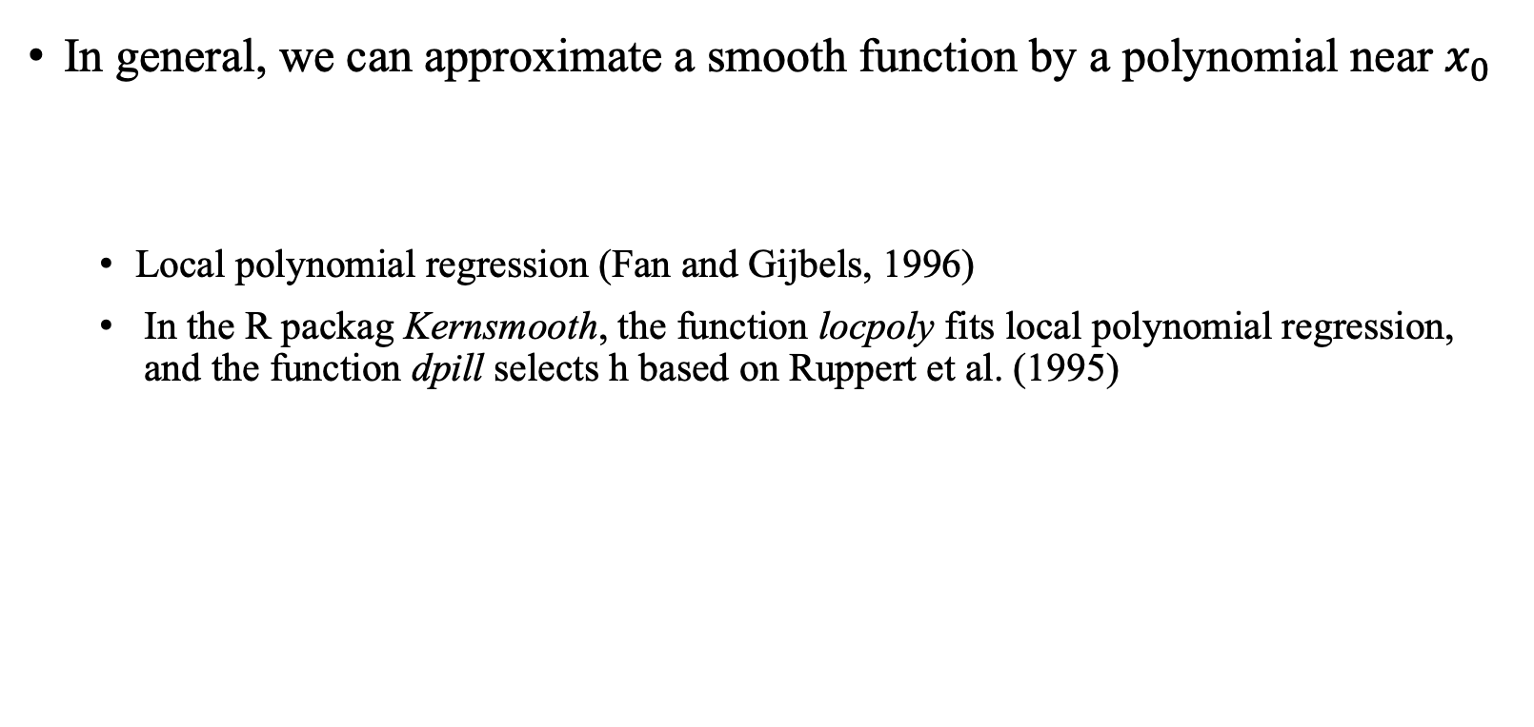
Local linear regression
In general, we can approximate a smooth function by a polynomial near $x_{0}$
Local polynomial regression (Fan and Gijbels, 1996)
In the R packag Kernsmooth, the function locpoly fits local polynomial regression, and the function dpill selects h based on Ruppert et al. (1995)

